Slide 1

Using Data Science
to improve Flight Operations
PRESENTED by R² Data Lab
© 2017 Rolls-Royce plc and/or its subsidiaries
The information in this document is the property of Rolls-Royce plc and/or its subsidiaries and may not be copied or communicated to a third party, or used for any purpose other than that for which it is supplied without the express written consent of Rolls-Royce plc and/or its subsidiaries.
This information is given in good faith based upon the latest information available to Rolls-Royce plc and/or its subsidiaries, no warranty or representation is given concerning such information, which must not be taken as establishing any contractual or other commitment binding upon Rolls-Royce plc and/or its subsidiaries.

Slide 2

Decades of experience turning data into insight
1,300
Aerospace Customers
of our Data Services
13,000
Engines,
and
6000-8000 commercial flights monitored per day in civil aerospace
Close to
30 Years
of experience
in Data Integration
and Analytics
Billions
of data points
analysed on-board
per flight
EHM
Notes:
For almost three decades, we have been using the power of data to give our customers greater control of, and insight into their operations.
We have close to 30 Years of experience in data integration and analytics
In the aerospace sector, today 1,300 Customers rely on our data services / we monitor 13,000 engines and 6000-8000 commercial flights per day
And analyse Billions of data points on-board per flight

Slide 3
Data growth and complexity
leading to
New game changing
business model and technology
Changing World
Notes:
The world is changing – data is connecting everybody and everything – the IT infrastructure if getting cheaper and the connectivity better – our customers are expecting more from us because of their own competitive pressure and domestic experience of digital technology.
RR is responding to these changes by adapting its business model and technology to become a fully digitally-enabled business.

Slide 4













The trusted partner creating
the most value for our Customers
from data innovation
Value from Data
Civil
Rolls-Royce
Nuclear
Defence
Analytics & Decision Support
Power Systems
Marine

Slide 5




Maximum value Connecting the end data system & stakeholders
Design Data
Design
Development Test-bed
Pass-off Test-bed
Manufacturing Data
Fleet Data
24│7│365
Aftermarket Services - Actionable insight
Key Sensors
Multiple RR Assembly Lines
RR and Network MRO Shops
RR Factories and Supply Chain
Factories
100,000
Factory Machines
Operational,
Contextual &
Third Party Data

Slide 6




Digital Cell concept
Sprint / Agile Working
Collaboration
Process
Digital Cells
Data Science
Decision Science
Business Analyst
Infrastructure
Business Leadership
Tools
Domain Expert
Data Engineers
App Developers
Customers
Digital Collaboration Platform
Ecosystem of Innovators
DevOps
Shared Data

Slide 7
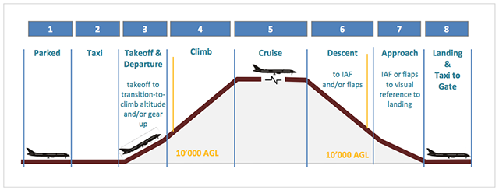
Flight Knowledge
Flight Phases

Slide 8
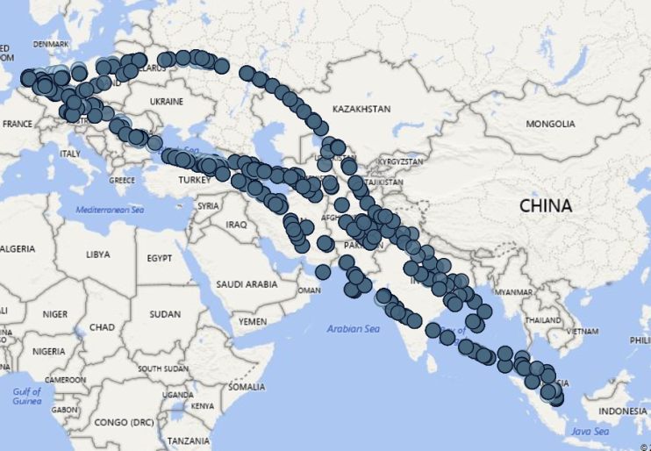
Flight Knowledge
Planned path vs Actual path
Cruise

Slide 9
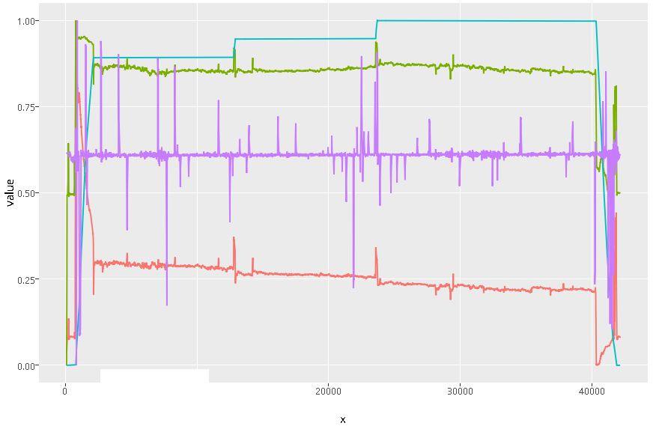
Flight Knowledge
In-flight record data (>1000 signals)

Slide 10
Use Cases
Fuel Efficiency
Safety Analysis
Predictive Maintenance

Slide 11
Fuel Efficiency Analysis
Observation by pilot: Fuel is sometimes more or less than the plan at some waypoints alone the flight path
Question: How can we utilize this observation to reduce the amount of burnt fuel? It would save both in economy and environment terms.
Waypoint | Planned Fuel Left | Actual Fuel Left
… | … | …
M | 120,000 | 121,000
N | 100,000 | 97,000
P | 70,000 | 60,000
… | … | …

Slide 12
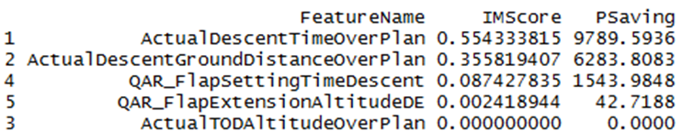
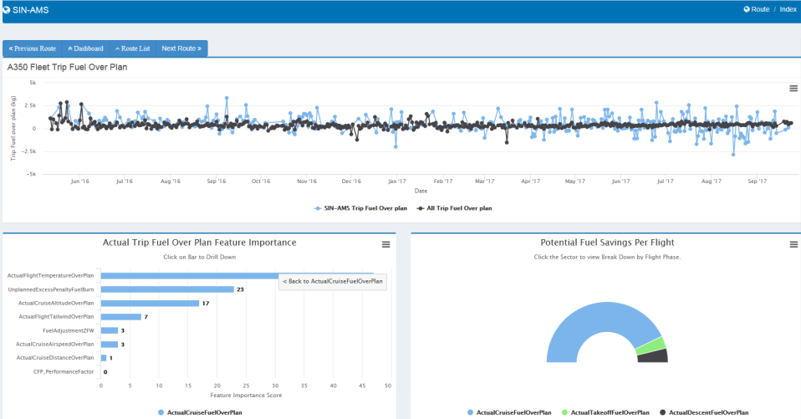
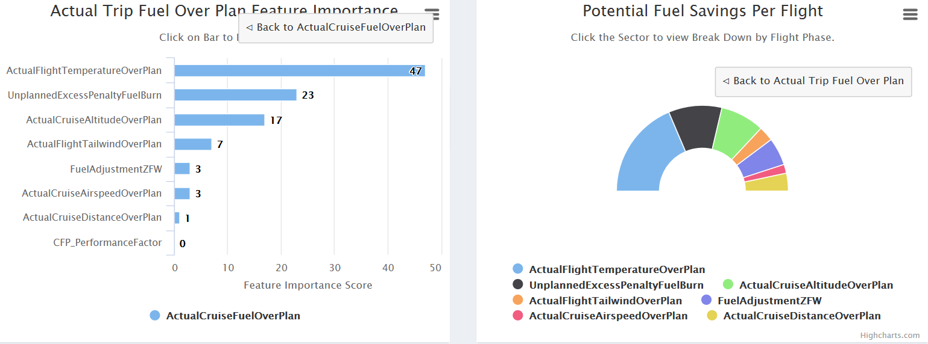
Fuel Efficiency – Multi-flight Analysis
Features are extracted based on flight dynamics and single-flight investigation.

Slide 13
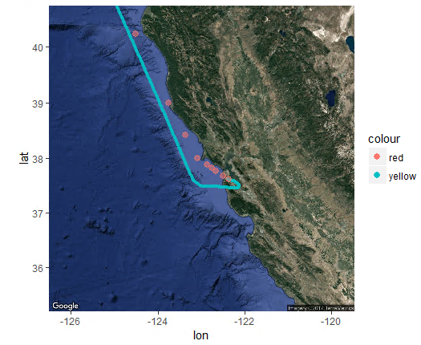
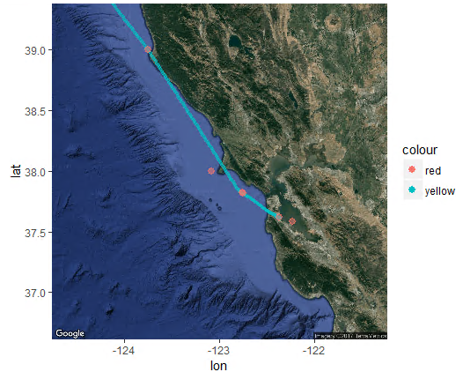
Insights – Take-off
Less efficient than planned
More efficient than planned

Slide 14
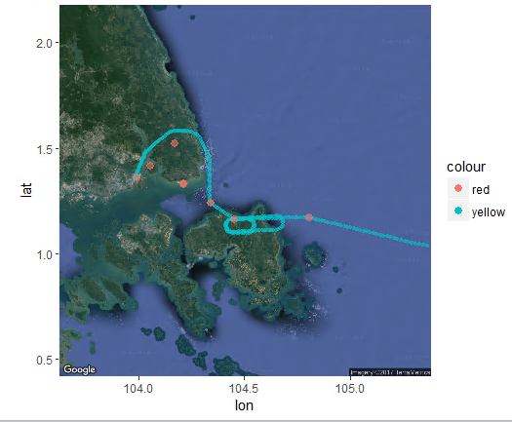
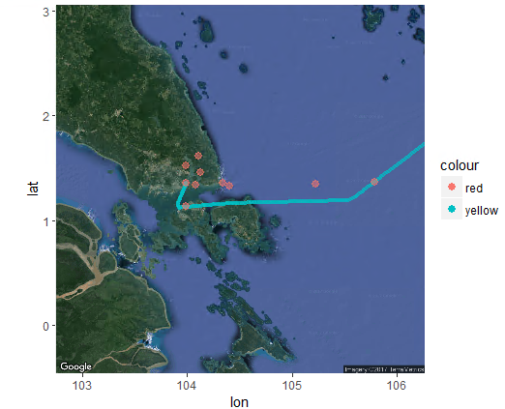
Insights – Descend
Less efficient than planned
More efficient than planned

Slide 15
Reflecting Points
Is the plan always fixed and correct for a route? Should we use the plan to label the data?
Normalize the plans in the same route
Optimize the plan to guide pilots better
What are the reasons pilots deviate from a plan?
Give advices to pilots to save fuel under certain circumstances.

Slide 16
Use Cases
Fuel Efficiency
Safety Analysis
Predictive Maintenance

Slide 17
Problem Description
The airline emphasizes on exploratory data analysis to find other possibilities of root causes that emerge recently and increase the chance of incidents.
They are keen on preventing future incidents by observing how risks trend.
Video: https://www.youtube.com/watch?v=_G2shnZ58h8

Slide 18
Design Flow
1
Integrate data
Signal Clusters
Pre-process
Time-series aggregation
Components iteratively refined
1 Hz Feature
2
Pairwise regression
Lasso
Random forest
Top-30 Signals
Correlation checked
4
Group Indices
3
Thresholding
Cross validation
Group Index Trend
Frequent itemsets
(Pairs of two)
Good/bad comparison
Correlation
strength
Distance Metrics
Network Viz
Hierarchical cluster
Notes:
Top-level flow:
Why 1Hz data instead of time-series segregation? How is the data presented?
Because we don’t have a fixed method to aggregate time series. One signal, 10s becomes 10 features.
Is there a correlation check among the features?
We asked pilots to pick uncorrelated signals, and also checked and removed correlated ones again in the Top-30.
Why are these three algorithms chosen?
Each represent a unique class of models, so they compliment each other.
Is any cross validation done?
Yes, after top-30 signals are chosen, cross-validation is done to validate the power of prediction.
How is thresholding done?
Looking at 95 percentile threshold for each signals in hard landing flights
Why is clustering needed?
To GROUP the signals because not just signal fault causes a hard landing but a combination.
Why does clustering follow frequent itemsets?
Frequent itemsets is only used to count the frequency of each pair of signals co-violated together. This results in a 2D matrix. Clustering is done on top of that matrix.

Slide 19
Feature Importance by Altitude
Feature Importance result by Altitude – based on one fleet landed at one airport.
At 350ft: Flare
At 250ft: Wind
At 200ft: Slope
At 50ft:Turbulence
At 1000ft: Gust Support
At 600ft_Roll
At 400ft: Slope
RUNWAY

Slide 20
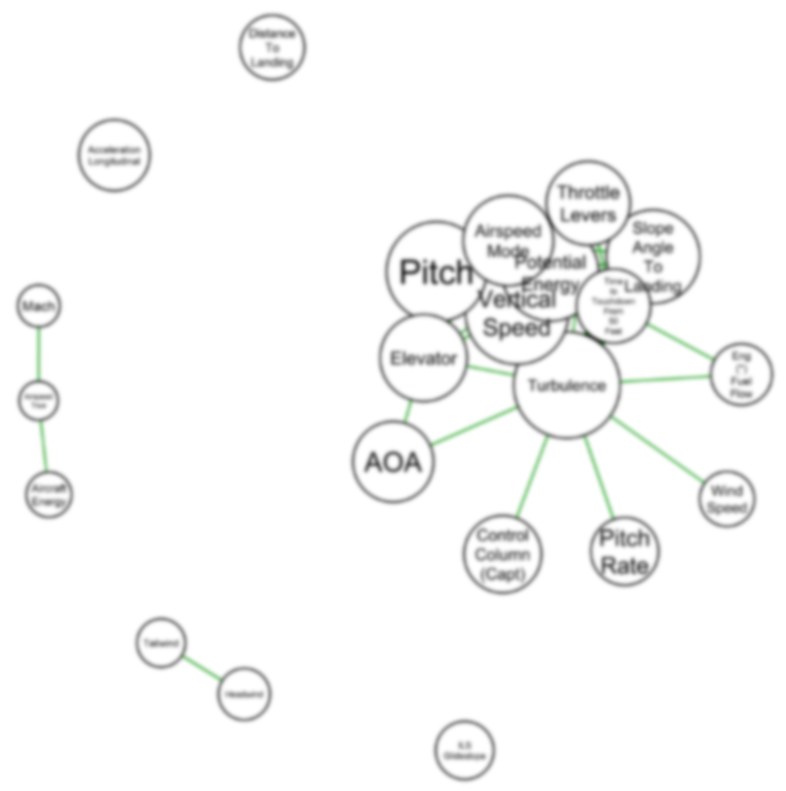
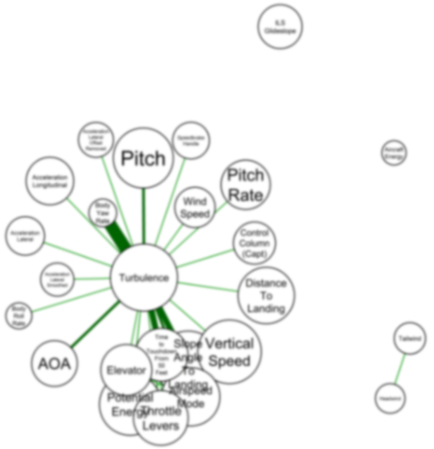
Co-violation Network for Hard Landings
BACK
2016
2017
A group that may trigger further investigation
New association
By forming groups, pilots can understand risk mechanisms and troubleshoot in focus.
Node size: how influential a signal is
Edge: indicates how often they co-occurs

Slide 21
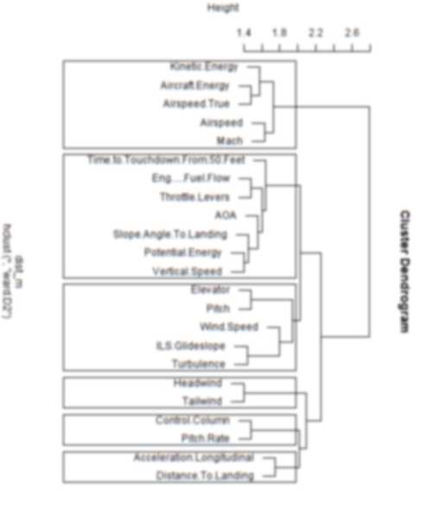
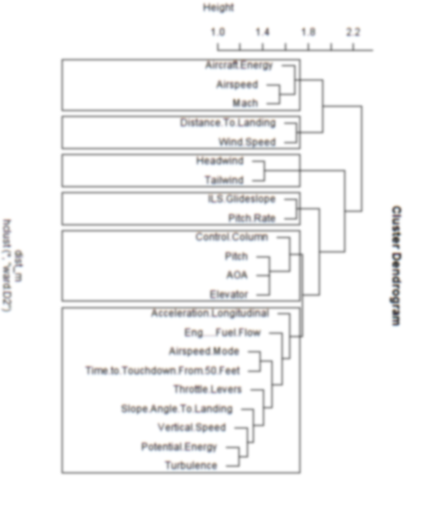
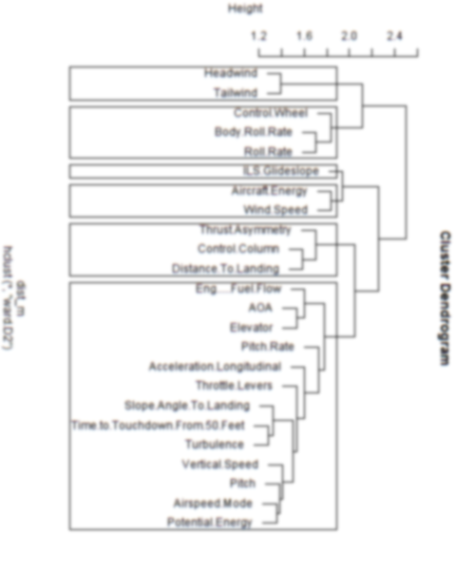
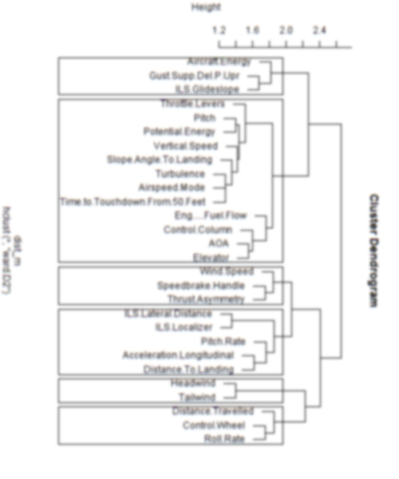
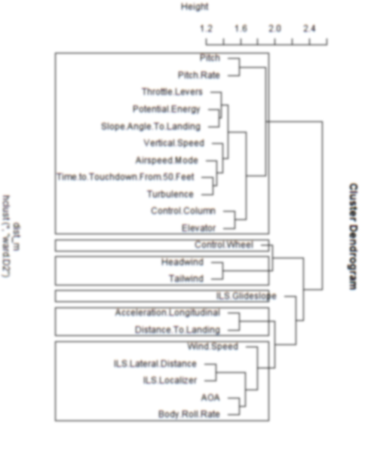
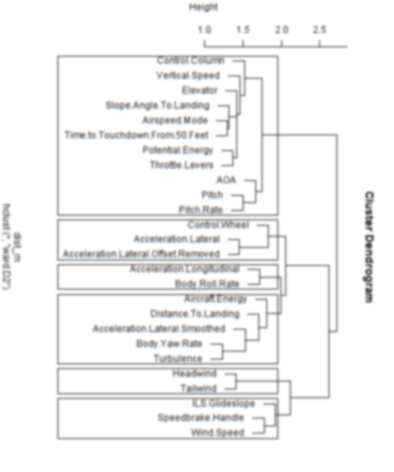
Identification of Emerging Groups
BACK
Feb 2017
Mar 2017
Apr 2017
May 2017
Jun 2017
Jul 2017

Slide 22
Use Cases
Fuel Efficiency
Safety Analysis
Predictive Maintenance

Slide 23

Data Sources per Aircraft per Failure
In-flight Data
Flights
Departure Time
Alarm Data
Investigation
Data
Pump failed on date D, electrical test X1, X2, X3, etc.
Different failure modes for a component

Slide 24
Metrics (1) - Labelling
Flights
Departure Time
Labelling strategies

Slide 25

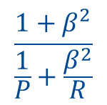
Metrics (2) – Model Evaluation
Customer requirements for early warnings:
True positive > 75% of total events
False positive < 10% of total events
0.1p
0.75p
0.25p
$$\frac{1+β^{2}}{\frac{1}{P}+\frac{β^{2}}{R}}$$
Model | Precision | Recall | F1
A | 75% | 88% | 81%
B | 80% | 90% | 84.7%
C | 78% | 95% | 85.7%

Slide 26
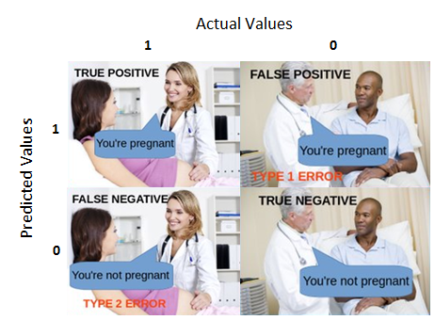

Slide 27
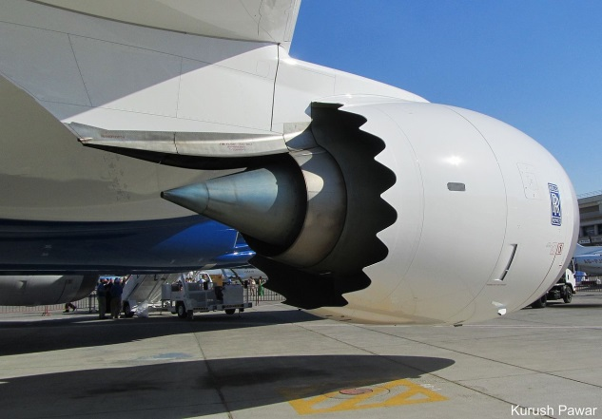

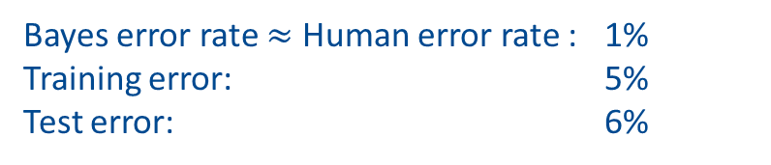
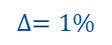
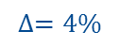
Model-tuning Prioritization
Human natural perception problems like image recognition or text understanding have rich-content data.
This company is a British multinational public limited company incorporated in February 2011 that owns a business established in 1904 related to today designs, manufactures and distributes power systems for aviation and other industries. The company is one of the world’s largest maker of aircraft engines and has major businesses in the marine propulsion and energy sectors.
Rolls Royce
Bayes error rate $≈$ Human error rate : 1%
Training error: 5%
Test error: 6%
(Focus to reduce this)
$$∆=4\%$$
$$∆=1\%$$

